Slide 1
Will you be my RooMMate?
WITH AI BASED COMPATIBILTY CHECK TO MATCH WITH THE PERFECT ONE
-Heera S

Slide 2
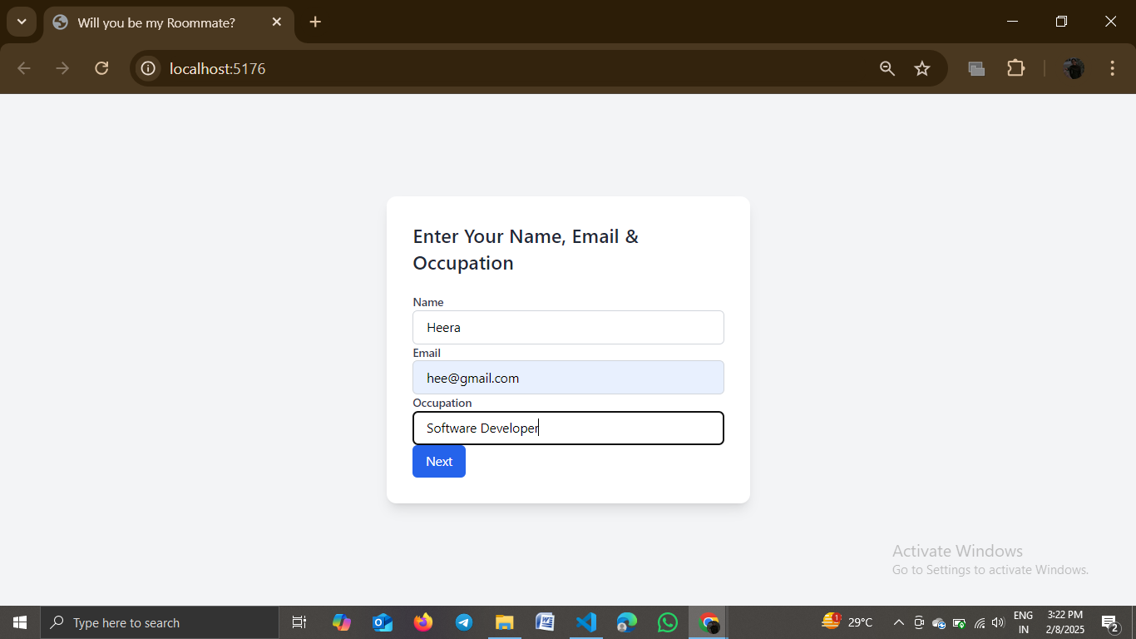
Login details

Slide 3
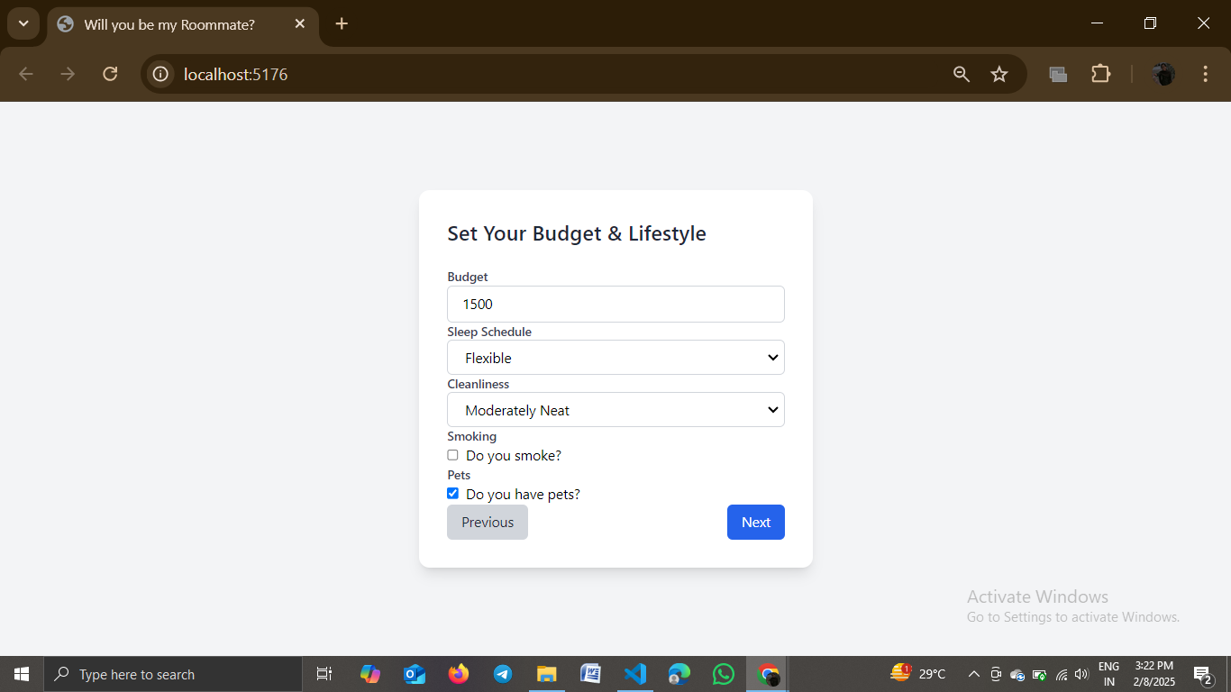
More personalized details

Slide 4
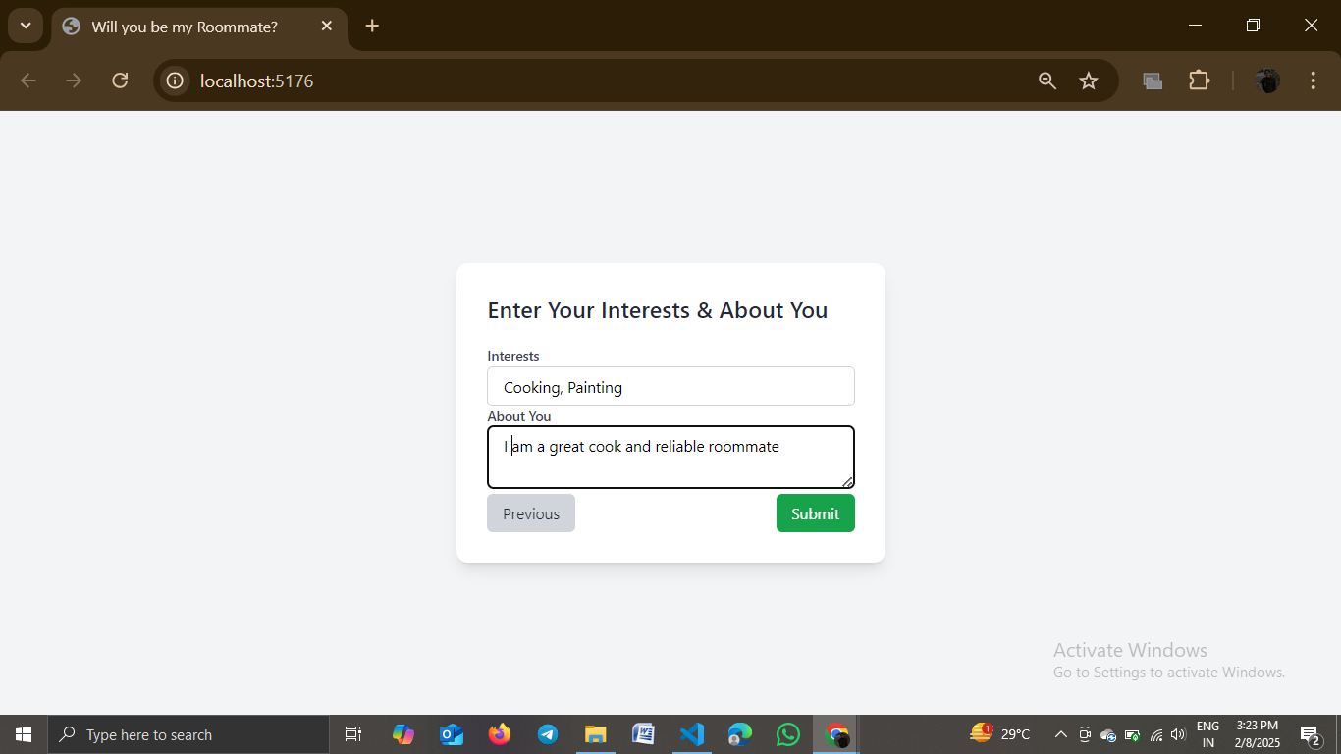
Self introduction

Slide 5
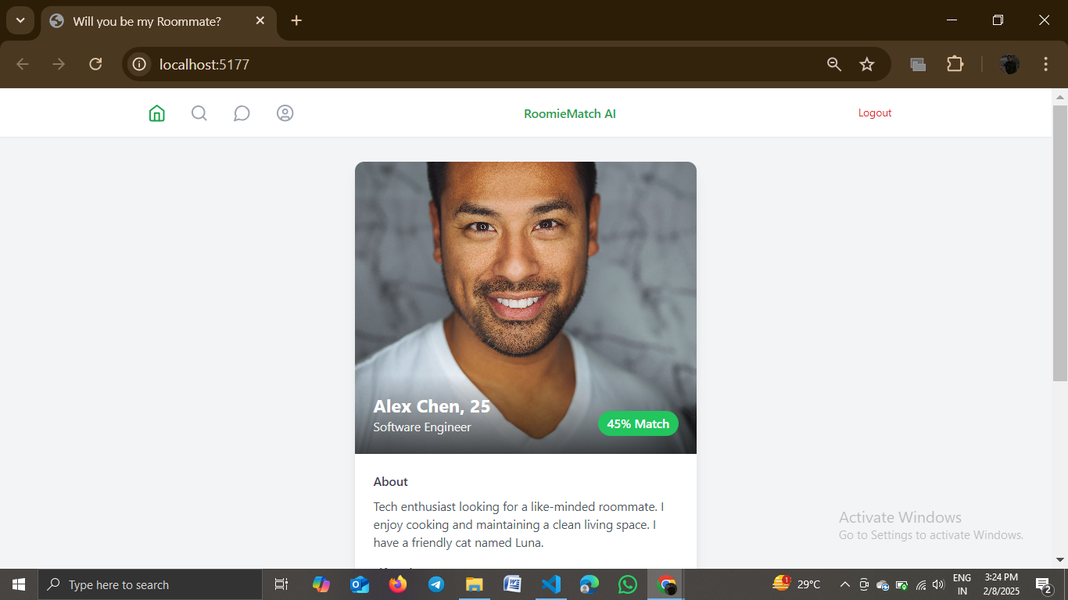
Home page with compatibilty check

Slide 6
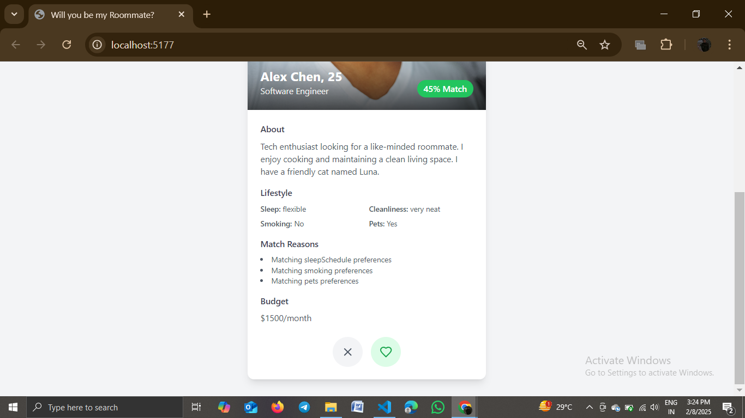
More details, can accept or reject

Slide 7
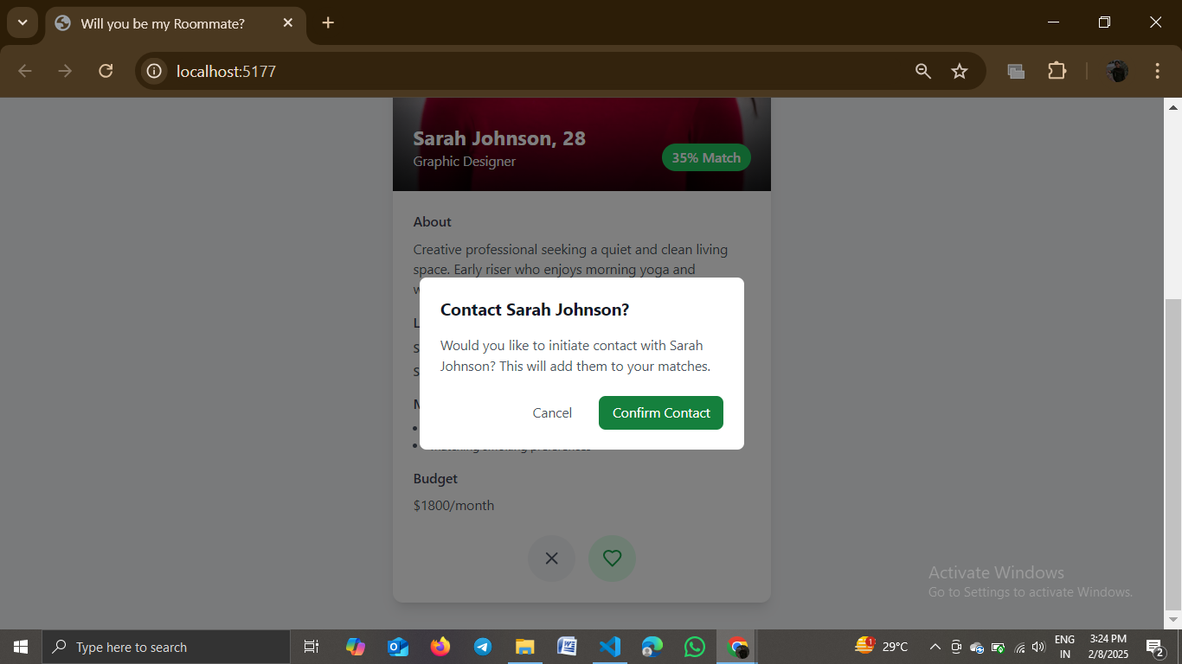
Confirmation

Slide 8
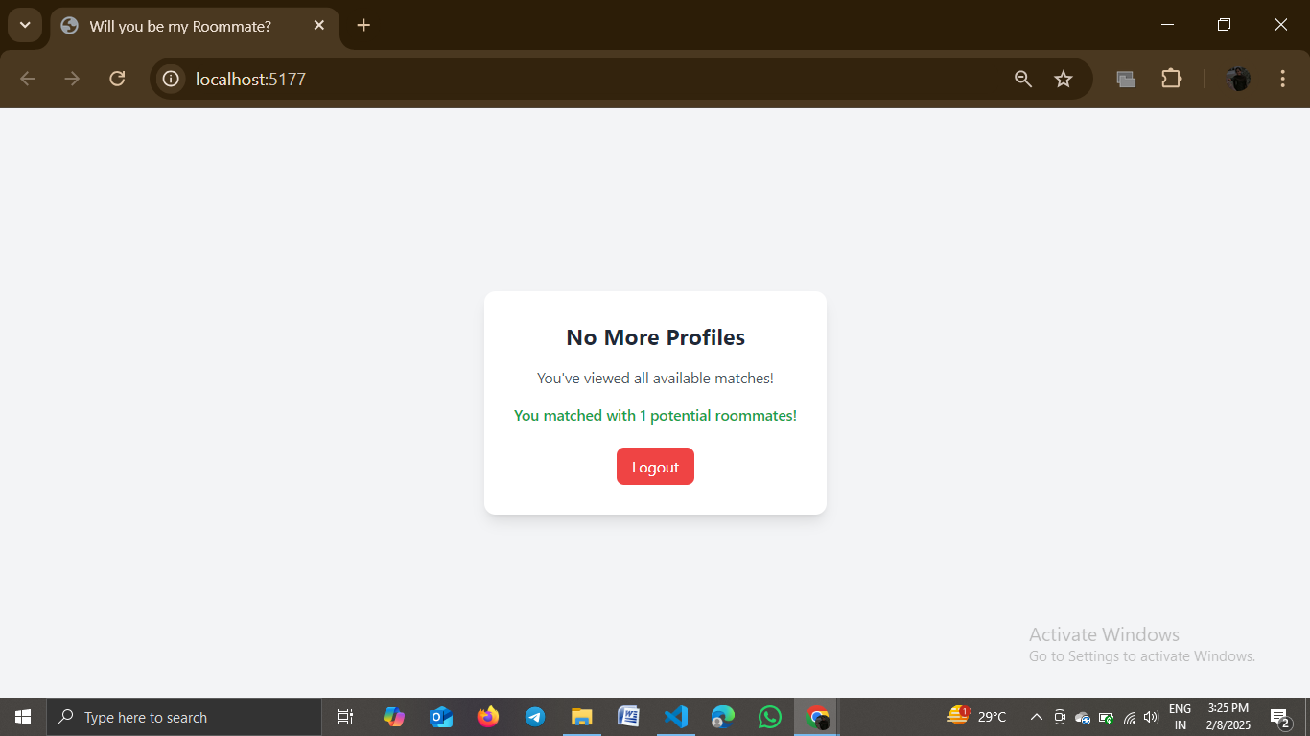
Logout page

